Slide 1


Introduction to Timers
AMERICAN INTERNATIONAL UNIVERSITY – BANGLADESH (AIUB)
Where leaders are created

Slide 2
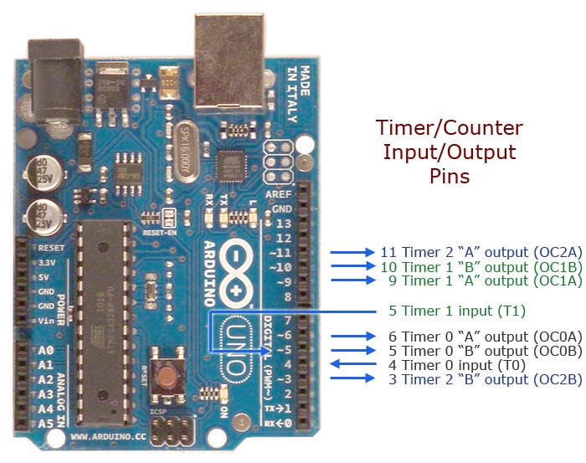
What is a Timer?
A timer/counter is like a clock, and can be used to measure time events.
The timer can be programmed by some special registers.
The controller of the Arduino is the ATmega328, which has 3 timers, called Timer0, Timer1 and Timer2.

Slide 3
What is a Timer?
Timer0 and Timer2 are 8-bit timers, whereas Timer1 is a 16-bit timer. The most important difference between 8-bit and 16-bit timers is the timer resolution.
8-bit timer is capable of counting 2⁸ = 256 steps from 0 to 255. 16-bit timer is capable of counting 2¹⁶ = 65536 steps from 0 to 65535.

Slide 4
Usefulness of Timer :
Timer is an important concept in the field of electronics. Every electronic component of a sequential logic circuit works on a time base to keep all the work synchronized.
An advantage of the timer is that it is totally independent of the CPU. Thus, it runs parallel to the CPU and there is no CPU’s intervention, which makes the timer quite accurate.
This is why using a timer is preferred for long delays instead of simply using the delay() function. The drawback of delay() is that your loop gets halted, and functions above and below the delay() are not being executed during this interval.

Slide 5
Usefulness of Timer :
A timer approach is a little harder to implement but the main loop keeps executing and only excludes the code and functions which a programmer wants to exclude.
If the programmer needs multiple tasks to occur at the same time or if the programmers' application requires that you constantly read/save data from inputs, use of the delay() function should be avoided.

Slide 6
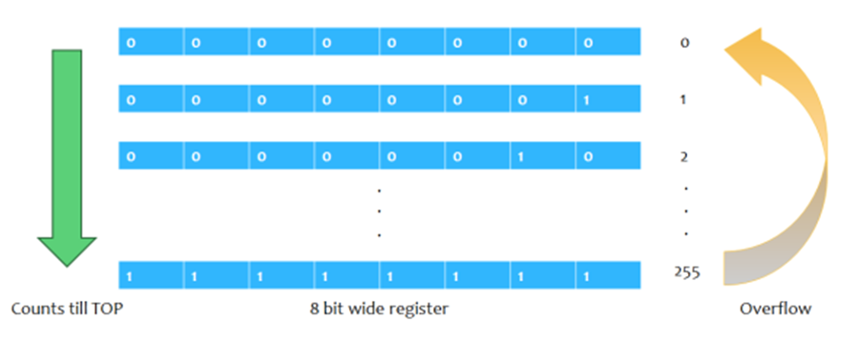
Timer Basics: Overflow
Due to this counting feature, timers are also known as counters. Once they reach their maximum possible value, the program does not stop executing and the timer count simply returns to its initial value of zero. In such a situation, we say that the timer/counter overflows.
For example, Timer0 is an 8-bit timer, meaning that it can count up from zero to 2⁸-1, or 255. Once that number is reached, the count resets back to zero and starts counting again.

Slide 7
How Timer Works?
Timers on the Arduino count up from zero, incrementing with every clock cycle of the oscillating crystal that drives Arduino.
If smaller frequencies are necessary, it is possible to “divide” the clock through an approach called pre-scaling.
How quickly timer reaches the target count depends on the clock divider. With no divider, the clock would go through 16 million cycles per second (16 MHz), and would overflow and reset this counter many times per second.
The three timers (called Timer0, Timer1, and Timer2) of Atmega328 can either be operated in one of these three modes, called normal mode, CTC mode, or PWM mode.
For lab experiment 3, we will operate it in normal mode (counter) using Timer0.

Slide 8
Timer Basics: Registers (Timer0)
The timer can be programmed by some special registers, where we can configure the pre-scaler for the timer, or the mode of operation and many other things necessary for proper operation.
The registers of interest for our purposes are:
Timer/Counter Register – TCNT0: to store timer count
Timer/Counter Control Register – TCCR0A and TCCR0B: to define operation mode and pre-scaler
Timer/Counter Interrupt Flag Register– TIFR0: to observe if there is any overflow
Output Compare Register - OCR0A and OCR0B: to match the timer count with some custom value (for CTC or PWM mode, not needed for normal mode)

Slide 9


Timer Basics: Registers (Timer0)
Timer/Counter Control Register A for Timer0 – TCCR0A: The bits WGM02 (from TCCR0B), WGM01 and WGM00 decide which mode the timer will run on.
Timer/Counter Control Register B for Timer0 – TCCR0B: The three Clock Select bits- CS02, CS01, CS00 select the clock source and pre-scalar value to be used by the Timer/Counter

Slide 10
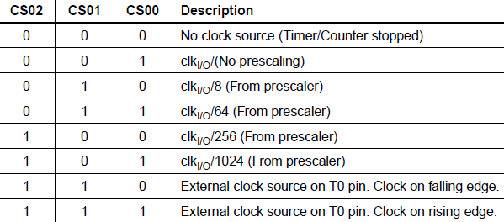
Timer Basics: Registers (Timer0)
Please note that if you do not initialize this register, all the bits will remain as zero and the timer/counter will remain stopped.

Slide 11

Timer Basics: Registers (Timer0)
Timer/Counter Register – TCNT0:
This is where the 8-bit value of the timer resides.
The value of the timer/counter is stored here and increases or decreases automatically.
Data can be both read or written from this register.
The register resets to zero after each overflow.

Slide 12



Timer Basics: Registers (Timer0)
Timer/Counter Interrupt Flag Register– TIFR0:
TOV0 bit is set (one) whenever TIMER0 overflows.
Output Compare Register - OCR0A and OCR0B:
Both Output Compare Registers A and B contain 8-bit values that are continuously compared with the counter value (TCNT0).
The OCF0A or OCF0B bit in the TIFR register is set (one) whenever the count matches the stored value.

Slide 13
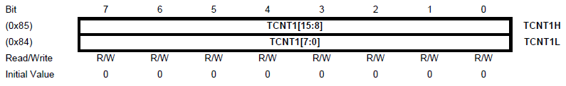
Timer Basics: Registers (Timer1)
Most of the registers are very similar to Timer0.
Timer/Counter Register – TCNT1H and TCNT1L (TCNT1):
The main difference between Timer0 and Timer1 is in the timer/counter register.
The two Timer/Counter I/O locations (TCNT1H and TCNT1L, combined TCNT1 of 16-bit) give direct access, both for read and write operations, to the Timer/Counter unit 16-bit counter.
The register resets to zero after each overflow.

Slide 14
Timer Basics: Registers (Timer1)
Most of the registers are very similar to Timer0.
Timer/Counter Register – TCNT1H and TCNT1L (TCNT1):
The other differences include-
The output compare registers are also 16 bit and made up from two 8-bit registers.
There is an extra Input Capture Register.
There are several extra modes Timer1 can run on.

Slide 15
Timer Basics: Terminology
Definitions of some commonly used terms in Timer:
BOTTOM: The counter reaches the BOTTOM when it becomes 0x00.
MAX: The counter reaches its maximum when it becomes 0xFF (decimal 255) in Timer0 and 0xFFFF (decimal 65535) in Timer1.
TOP: The counter reaches the TOP when it becomes equal to the highest value in the count sequence. The TOP value can be assigned to be the fixed value (MAX) or the value stored in the OCRnA or OCRnB Register. The assignment is dependent on the mode of operation.

Slide 16
Timer Modes: Normal Mode
The simplest mode of operation is the Normal mode. In this mode, the counting direction is always up (incrementing), and no counter clear is performed.
The counter simply overflows when it passes its maximum value and then restarts from zero.
In normal mode of operation, the Timer/Counter Overflow Flag (TOV0) will be set in the same timer clock cycle as the TCNT0 becomes zero.

Slide 17
Timer Modes: Clear Timer on Compare, CTC Mode
In Clear Timer on Compare or CTC mode, the counter is cleared to zero when the counter value (TCNT0) matches a value stored in either OCR0 (OCR0A or OCR0B) registers.
When the desired value is reached, a flag in a status register is set to ‘1’.
This method can be more efficient than comparing bytes to detect a match as checking a single flag is simpler.

Slide 18
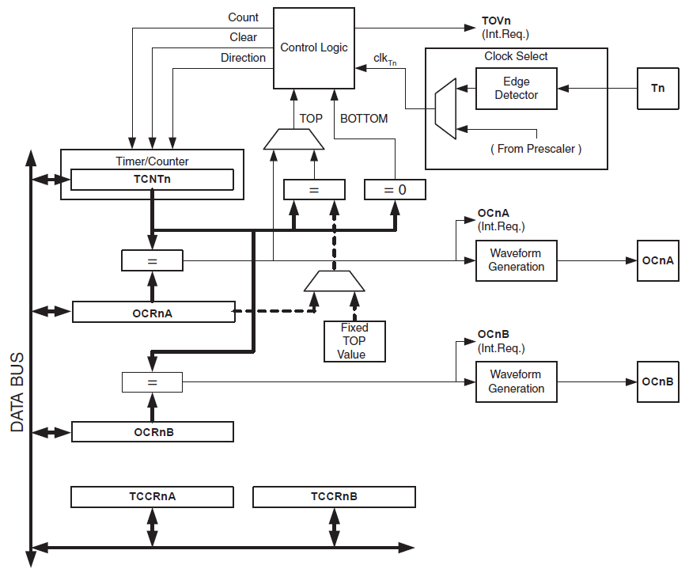
Counter Unit
Red: signals entering/exiting a block
Green: description of a block
2a. Every clock period, signals the Timer to increment/decrement
3c. Timer/Counter overflow flag set when timer overflows (goes beyond maximum value)
Red: signals entering/exiting a block
Green: description of a block
Red: signals entering/exiting a block
Green: description of a block
2b. Sets the timer’s count to zero
2c. Chooses between increment and decrement
1. Timer clock is chosen
Contains the current timer count
0a. External clock source
3a. Signals that timer count has reached maximum
3b. Signals that timer count has reached minimum
0b. System clock (may or may not be pre scaled)

Slide 19
Output Compare Unit
6a. Signals that timer count has reached maximum
6b. Signals that timer count has reached minimum
Comparator (checks if zero)
Comparator
1. Current timer count
OCFnA
7a. Output compare flag set, interrupt generated if enabled
1. Current timer count
5. Maximum timer value chosen
Comparator
3a. Sends signal if inputs equal
8a. generate a
PWM or variable frequency output
2a. Count stored in OCRnA
4. Count stored in OCRnA
OCFnB
7b. Output compare flag set, interrupt generated if enabled
1. Current timer count
Comparator
2b. Count stored in OCRnB
3b. Sends signal if inputs equal
8b. generate a
PWM or variable frequency output
Red: signals entering/exiting a block (Normal mode)
Blue: signals entering/exiting a block (CTC/PWM mode)
Green: description of a block

Slide 20
decides which mode the timer will run on and decides the pre-scaler for the timer clock

Slide 21
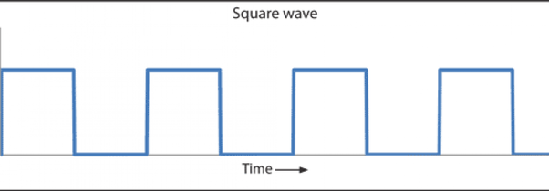
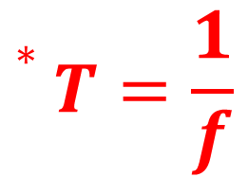
Timer for Delay: Calculating Count
Timer needs a clock pulse for each transition from one number to the next, so we want to establish a formula relating the necessary timer count for a specific delay with the timer clock period/frequency.
For F_CPU = 16 MHz, the system clock period = 1/16MHz = 62.5 ns*. So, if the timer clock is the same as the system clock, it takes only 62.5 ns for every transition (0 to 1, 1 to 2, etc.).
187.5 ns
$$∗T=\frac{1}{f}$$
62.5 ns
62.5 ns
62.5 ns
Count = 0
Count = 1
Count = 2

Slide 22
Timer for Delay: Calculating Count
We can see that 3 time periods are needed to count to 2, so timer count = (number of periods needed to reach the count) -1.
Also, we can see that to get a delay of 187.5 ns, we need 3 periods lasting 62.5 ns, so the number of periods needed = Required delay/Timer clock period.
187.5 ns
62.5 ns
62.5 ns
62.5 ns
Count = 0
Count = 1
Count = 2

Slide 23

Timer for Delay: Calculating Count
Suppose, we need a delay of 1 ms. To get an idea of how long it takes, let’s calculate the timer count from the following formula:
$$Timer count=\frac{Required delay}{Timer clock period}−1$$ Here, required delay = 1 ms and timer clock period = 62.5 ns, so Timer Count = (1m/62.5n) – 1 = 15,999.
So, the clock needs to tick 15,999 times to give a delay of only 1 ms.

Slide 24
Timer for Delay: Calculating Count
Maximum possible delay for Timer0 (which is an 8-bit timer) at 16 MHz : 62.5 ns × 256 = 16 μs
Maximum possible delay for Timer1 (which is a 16-bit timer) at 16 MHz: 62.5 ns × 65,536 = 4.096 ms
If we plan to get delays simply by directly counting at system frequency, it is difficult to use an 8-bit timer (as it has an upper limit of 255, after which it overflows, and resets count to zero). Even with a 16-bit timer (which can count to 65,535), it is not possible to get longer delays.

Slide 25
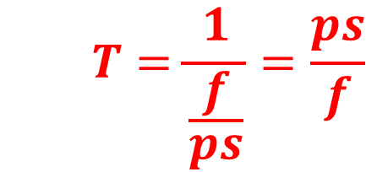

Timer for Delay: Calculating Count
To stay in the safe side, we use the highest available pre-scalar and reduce timer clock frequency to 16MHz/1024 = 15625 Hz, with a new timer clock period (= System clock period × pre-scalar) = 62.5ns×1024 = 64 μs. Now, the needed timer count = (1ms/64μs) – 1 = 14.625. Now that Timer clock frequency = System clock frequency/pre-scalar, we can update the equation
$$Timer count=\frac{Required delay}{Timer clock period}−1$$
to
$$Timer count=\frac{Required delay×System clock frequency}{prescalar (ps)}−1$$
$$T=\frac{1}{\frac{f}{ps}}=\frac{ps}{f}$$

Slide 26
Timer for Delay: Calculating Count
Maximum possible delay for Timer0 at 15625 Hz: 64 μs × 256 = 16.384 ms
Maximum possible delay for Timer1 at 15625 Hz: 64 μs × 65536 = 4.194304 s
To get longer delays, we will use Timer1, and for delays longer than 4 s, nested if statements can be used.

Slide 27
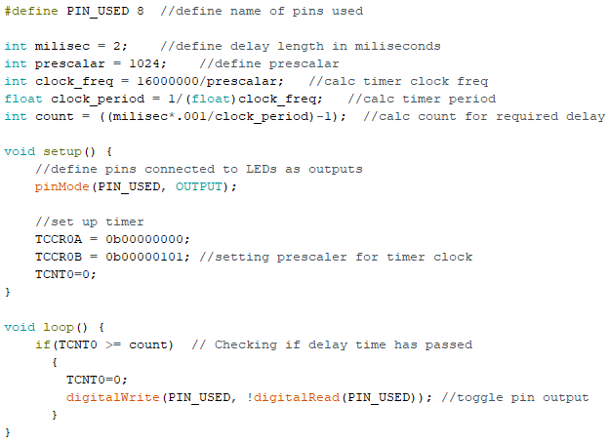
Problem Statement 1
Make an LED blink every 2 milliseconds while using Arduino system frequency (F_CPU) 16 MHz, using timer to generate the delay without any application of delay() function. Delay = 2 ms, so Timer0 can be used with pre-scalar 1024.
Number of count needed to reach 2 ms = (2,000 μs/64 μs) – 1 = 30.25 ≈ 31.
WGM01 and WGM00 set to zero for normal mode
WGM02 set to zero for normal mode, CS02, CS01, CS00 set to 1,0,1 for pre-scalar 1024
Make LED blink

Slide 28
Problem Statement 2
Make an LED to blink every 2 seconds while using Arduino system frequency (F_CPU) 16 MHz, using a timer to generate the delay without any application of delay() function.
Delay = 2 s, so Timer1 (remember that it is a 16-bit timer) can be used with the pre-scalar value of 1024.
Number of count required to get a delay of 2 s = (2,000,000 μs/64 μs) – 1 = 31,249.

Slide 29
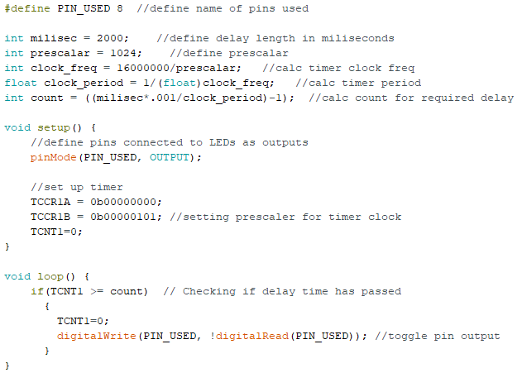
Code:
Same code, only register names have 1 instead of 0 and delay length changed!
Set-up registers are 8-bits even though the Timer is 16-bit

Slide 30
References
ATMega328 manual
https://www.avrfreaks.net/forum/tut-c-newbies-guide-avr-timers
http://maxembedded.com/2011/06/avr-timers-timer0/

Slide 31
Thanks for attending….
?

